Slide 1
Agile Project Management Infographics
Here is where this template begins

Slide 2
Agile project management infographics
Kanban board
Backlog | Accepted | Implement | Test | Done
Despite being red, Mars is cold | Neptune is far away from Earth |  | Venus is the second planet from the Sun | Pluto is considered a dwarf planet
Saturn is a gas giant and has several rings | Earth is the third planet from the Sun |  | The Sun is a huge and hot star | Uranus is the seventh planet from the Sun
Jupiter is the biggest planet of them all | Mercury is the smallest planet |  | Ceres is in the main asteroid belt | The Moon is Earth’s only natural satellite
X
X
X
To do
In progress
Done
Saturn is a gas giant
Mercury is a small planet
Jupiter is a big planet

Slide 3
Agile project management infographics
Traditional
01
Mercury
Mercury is the closest planet to the Sun and the smallest one
01
Jupiter
It’s a gas giant and the biggest planet of them all
02
Neptune
The agile method vs. traditional
Neptune is the farthest planet from the Sun
02
Saturn
Saturn is a gas giant and has several rings
03
Mars
Despite being red, Mars is actually a very cold place
03
Venus
Venus is the second planet from the Sun
Agile

Slide 4
Agile project management infographics
Construction
Analysis
Feedbacks
Prework
Mercury is the closest planet to the Sun
Earth is the third planet from the Sun
Venus is the second planet from the Sun
Jupiter is the biggest planet of them all
02
01
03

Slide 5
Agile project management infographics
Deliver fast
Defer commitment
Despite being red, Mars is a cold place
Neptune is the farthest planet from the Sun
Lean agile
Optimize everything
Build quality
Venus has a beautiful name, but it’s terribly hot
Earth is the third planet from the Sun
Respect people
Create knowledge
Saturn is a gas giant and has several rings
Mercury is the smallest planet in the Solar System

Slide 6
Agile project management infographics
Task | Owner |  | Content | Design | Status | Date
Mars is a cold place | Mars |  | Done | Done | Published | Apr 24
Mercury is the smallest planet | Mercury |  | Done | In process | On hold | Aug 23
It is a biggest planet | Jupiter |  | On hold | In process | Review | Sep 12
It has a beautiful name | Venus |  | Done | On hold | On hold | October 1
It is far away from the Sun | Neptune |  | Done | In process | Review | October 4

Slide 7
Agile project management infographics
Design
Build
Mercury is the closest planet to the Sun
Despite being red, Mars is a cold place
Receive
Review
Agile development
Jupiter is the biggest planet of them all
Venus is the second planet from the Sun
Feedback
Stop
Release
The Moon is Earth’s only natural satellite
Earth is the third planet from the Sun
Neptune is far away from Earth

Slide 8
Agile project management infographics
PDCA cycle
4
1
Act
Plan
Mercury is the smallest planet of them all
Venus is the second planet from the Sun
3
2
Check
Do
Despite being red, Mars is actually a cold place
Jupiter is the biggest planet of them all

Slide 9
Agile project management infographics
 | Q1 2022 |  |  | Q2 2022 |  |  | Q3 2022 |  |  | Q4 2022
Phases
Tools
Product
Start agile roll-out
Feedback
Transition between phases
Set up JIRA
Agile training
Metrics and tools
Integrate confluence
Design
Test
Build
Deployment

Slide 10
Agile project management infographics
Agile workflow
Design
Testing
Saturn is a gas giant and has several rings
Venus is the second planet from the Sun
Envision
Planning
Jupiter is the biggest planet of them all
Neptune is the farthest planet from the Sun
Earth is the third planet from the Sun
Delivery
Feedback
Mars is a cold place full of iron oxide dust

Slide 11
Agile project management infographics
Sprints in agile project management
First sprint
01
03
Third sprint
Mercury is the closest planet to the Sun and the smallest one
Venus has a beautiful name and is the second planet from the Sun
Despite being red, Mars is a cold place. It’s full of iron oxide dust
Jupiter is a gas giant and the biggest planet in the Solar System
02
04
Second sprint
Four sprint

Slide 12
Agile project management infographics
Tasks | Date | Status | Responsible
Mercury is the smallest planet of them all | Sep 12 | Completed | John Doe
Jupiter is the biggest planet of them all | Nov 14 | In progress | Jena Tomson
Despite being red, Mars is a cold place | Jan 20 | On hold | Timmy Jimmy
Jan | Feb | Mar | Apr | May | Jun | Jul | Aug | Sep | Oct | Nov | Dec

Slide 13
Agile project management infographics
Agile attributes
1
2
Transparency
Customer focus
Despite being red, Mars is a cold place
Jupiter is the biggest planet of them all
4
3
Improvement
Adaptability
Earth is where we all live together
Saturn is a gas giant with several rings

Slide 14
Agile project management infographics
Kanban board
Backlog | Development ongoing | Development done | Testing ongoing | Testing done | Done
Mars is cold
Venus is hot
Mercury is small
Neptune is far
Jupiter is big

Slide 15
Agile project management infographics
Agile project management methodology
Jupiter is the biggest planet of them all
Mercury is the smallest planet
Despite being red, Mars is a cold place
Venus is the second planet from the Sun
Sprint backing
Product
Sprint planning
Visibility
2
4
6
8
1
3
5
7
Sprint
Product owner
Release
Execution
Neptune is far away from Earth
Earth is the third planet from the Sun
The Moon is Earth’s only natural satellite
Saturn is a gas giant with several rings

Slide 16
Agile project management infographics
Sprint 1
60%
Venus has a beautiful name and is the second planet from the Sun
Sprint 2
65%
Jupiter is a gas giant and the biggest planet in the Solar System
Sprint 3
70%
Mercury is the closest planet to the Sun and the smallest one
Sprint 4
75%
Despite being red, Mars is actually a cold place. It’s full of iron oxide dust

Slide 17
Agile project management infographics
Task 1
Task 2
Task 3
Task 4
Task 5
Jupiter is the biggest planet
Neptune is far away from Earth
Earth is the third planet from the Sun
Mercury is the smallest planet
Venus is the second planet from the Sun
Jan | Feb | Mar | Apr | May | Jun | Jul | Aug | Sep | Oct | Nov | Dec

Slide 18
Agile project management infographics
Decentralized decision-making
Lisa Doe
David Davids
Saturn is a gas giant with several rings
Mars is a cold place full of iron oxide dust
Anna Smith
Luisa Schneider
Jupiter is the biggest planet of them all
Venus is the second planet from the Sun
John Johnson
Sean Tresnor
Neptune is the farthest planet from the Sun
Mercury is the closest planet to the Sun
Martin Louis
Elena Mathison
Earth is the third planet from the Sun
The Moon is Earth’s only natural satellite

Slide 19
Agile project management infographics
Agile sprint
Design
Deployment
2
5
Saturn is a gas giant and has several rings
Jupiter is a gas giant and the biggest planet
1
Requirements
3
Testing
6
4
Neptune is far away from Earth
Despite being red, Mars is actually a cold place
Review
Development
Earth is the third planet from the Sun
The Moon is Earth’s only natural satellite

Slide 20
Agile project management infographics
Tasks | To do | In progress | Testing | Done
Pluto is considered a dwarf planet
Earth is the third planet from the Sun
Uranus is seventh planet from the Sun
Venus is the second planet from the Sun
Jupiter is the fifth planet from the Sun
Mars is actually a very cold place
Mercury is the smallest planet of them all
Task 01
Task 02
Task 03
Task 04
Task 05
Task 06
Task 07

Slide 21
Agile project management infographics
Agile project management process
Envision
Speculate
Explore
Adapt
Close
Earth is the third planet from the Sun
Neptune is far away from Earth
The Moon is Earth’s only natural satellite
Saturn is a gas giant with several rings
Mars is actually a very cold place

Slide 22
Agile project management infographics
Agile planning onion
5
Portfolio
6
Strategy
Despite being red, Mars is actually a cold place
Earth is the third planet from the Sun
3
Release
4
Product
Venus has a beautiful name, but it’s terribly hot
Mercury is the smallest planet of them all
1
Daily
2
Iteration
Saturn is a gas giant and has several rings
Neptune is the farthest planet from the Sun

Slide 23
Agile project management infographics
 | First semester |  |  |  |  |  | Second semester
Tasks | Jan | Feb | Mar | Apr | May | Jun | Jul | Aug | Sep | Oct | Nov | Dec
Task 1 | 23 |  |  | 7
Task 2 |  |  |  |  | 11 |  |  |  |  |  | 18
Task 3 | 8 |  |  |  |  |  | 1
Task 4 |  | 19 |  |  |  |  |  |  | 12
Emilie Doe
Anton Smith
Maeve Davids
Tom Wilson
Neptune is the farthest planet from the Sun
Earth is the third planet from the Sun
Mercury is the smallest planet of them all
Despite being red, Mars is actually a cold place

Slide 24
Agile project management infographics
Agile methodology
Conception
Analysis
Design
Testing
Deployment
Mercury is the smallest planet of them all
Venus is the second planet from the Sun
Despite being red, Mars is a cold place
Jupiter is the biggest planet of them all
Saturn is a gas giant and has several rings

Slide 25
Agile project management infographics
Conception
Conception
Agile
Mercury is the smallest planet
Ceres is a dwarf planet
Analysis
Analysis
Mars is actually a cold place
Pluto is a dwarf planet
Construction
Construction
Waterfall
Jupiter is the biggest planet
The Moon is a natural satellite
Testing
Testing
Venus has a beautiful name
The Sun is a huge star
Deployment
Deployment
Saturn is a gas giant with rings
Earth is where we all live

Slide 26
Agile project management infographics
Weekly progress
M | T | W | T | F | S | S
Step progress
Goals | Task 1 | Task 2 | Task 3 | Task 4
Goal 1
Goal 2
Mars is a cold place
Venus has a nice name
Tasks | Jan | Feb | Mar | Apr | May | Jun | Jul | Aug | Sep | Oct | Nov | Dec
Task 1 | x | x
Task 2
Task 3 | x | x | x | x | x
Current month
Completed
On progress
Not started yet
Saturn is a gas giant
Jupiter is a gas giant
Neptune is far away
Mercury is small

Slide 27
Agile project management infographics
5
Feedback loops
Mercury is the closest planet to the Sun
Data driven
1
Customer needs
Jupiter is the biggest planet of them all
4
Delivery
Earth is the third planet from the Sun
Focus on work
2
Saturn is a gas giant and has several rings
3
Built-in quality
Venus is the second planet from the Sun

Slide 28
Agile project management infographics
Neptune is the farthest planet from the Sun
Mercury is the smallest planet of them all
Earth is the third planet from the Sun
1
Sprint planning
3
Product
5
Sprint backing
Release planning
2
Product owner
4
Sprint
6
Jupiter is the biggest planet of them all
Saturn is a gas giant and has several rings
Ceres is located in the main asteroid belt

Slide 29
Agile project management infographics
2023 | Project 1 | Project 2 | Project 3 | Project 4
January
February
March
April
May
June
July
August
September
October
November
December
Jupiter is the biggest planet in the Solar System and a gas giant
Mercury is the closest planet to the Sun and the smallest one
Venus is the second planet from the Sun and it is very hot
Despite being red, Mars is a very cold place full of iron oxide dust

Slide 30
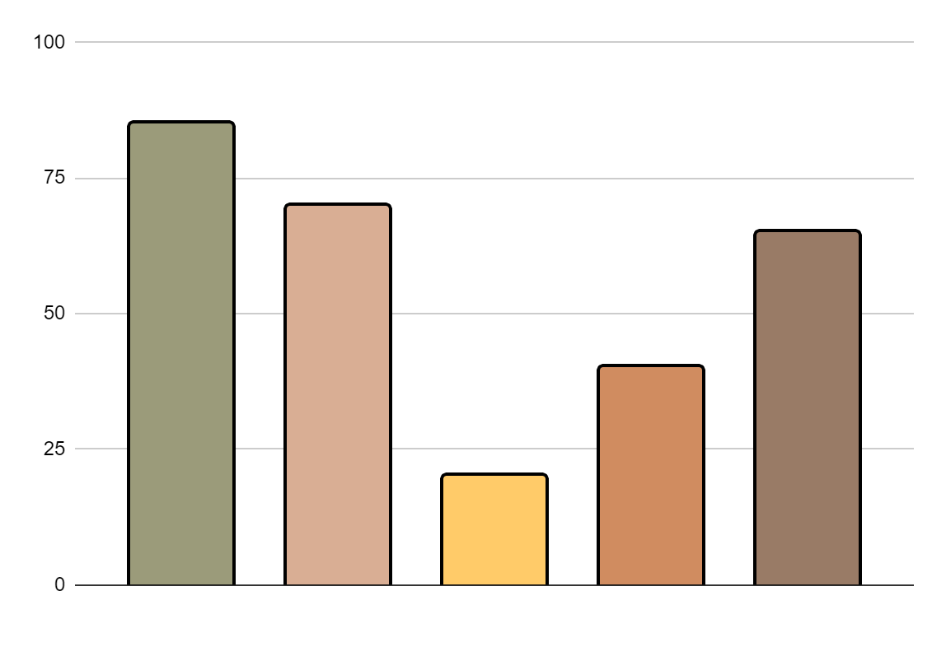
Agile project management infographics
First phase
Mercury is the smallest planet
Second phase
Mars is actually a cold place
Third phase
Jupiter is the biggest planet
Fourth phase
Venus has a beautiful name
Fifth phase
80%
73%
23%
45%
68%
Saturn is a gas giant with rings
Follow the link in the graph to modify its data and then paste the new one here. For more info, click here

Slide 31
Agile project management infographics
Plan
1
Test
Design
3
4
2
Develop
Neptune is the farthest planet from the Sun
Earth is the third planet from the Sun
Ceres is located in the main asteroid belt
Despite being red, Mars is actually a cold place
4
Deploy
5
Review
6
3
Agile
Jupiter is the biggest planet of them all
Venus has a nice name but it is very hot
5
2
Launch
7
1
6
7
Mercury is the smallest planet of them all

Slide 32
Instructions for use
In order to use this template, you must credit Slidesgo in your final presentation.
You are allowed to:
- Modify this template.
- Use it for both personal and commercial projects.
You are not allowed to:
- Sublicense, sell or rent any of Slidesgo Content (or a modified version of Slidesgo Content).
- Distribute Slidesgo Content unless it has been expressly authorized by Slidesgo.
- Include Slidesgo Content in an online or offline database or file.
- Offer Slidesgo templates (or modified versions of Slidesgo templates) for download.
- Acquire the copyright of Slidesgo Content.
For more information about editing slides, please read our FAQs or visit Slidesgo School:
https://slidesgo.com/faqs and https://slidesgo.com/slidesgo-school

Slide 33
Instructions for use (premium users)
As a Premium user, you can use this template without attributing Slidesgo
You are allowed to:
Modify this template.
Use it for both personal and commercial purposes.
Hide or delete the “Thanks” slide and the mention to Slidesgo in the credits.
Share this template in an editable format with people who are not part of your team.
You are not allowed to:
Sublicense, sell or rent this Slidesgo Template (or a modified version of this Slidesgo Template).
Distribute this Slidesgo Template (or a modified version of this Slidesgo Template) or include it in a database or in any other product or service that offers downloadable images, icons or presentations that may be subject to distribution or resale.
Use any of the elements that are part of this Slidesgo Template in an isolated and separated way from this Template.
Register any of the elements that are part of this template as a trademark or logo, or register it as a work in an intellectual property registry or similar.
For more information about editing slides, please read our FAQs or visit Slidesgo School:
https://slidesgo.com/faqs and https://slidesgo.com/slidesgo-school

Slide 34
Infographics
You can add and edit some infographics to your presentation to present your data in a visual way.
Choose your favourite infographic and insert it in your presentation using Ctrl C + Ctrl V or Cmd C + Cmd V in Mac.
Select one of the parts and ungroup it by right-clicking and choosing “Ungroup”.
Change the color by clicking on the paint bucket.
Then resize the element by clicking and dragging one of the square-shaped points of its bounding box (the cursor should look like a double-headed arrow). Remember to hold Shift while dragging to keep the proportions.
Group the elements again by selecting them, right-clicking and choosing “Group”.
Repeat the steps above with the other parts and when you’re done editing, copy the end result and paste it into your presentation.
Remember to choose the “Keep source formatting” option so that it keeps the design. For more info, please visit Slidesgo School.

